Slide 1



Slide 2
MOST IMPORTANT: PRESENTATION (PITCH DECK) STRUCTURE
1) Team
2) Selected challenge / problem to be solved
3) Proposed solution / product
4) Level of completion.
5) Customers / Users. Who are they?

Slide 3
MOST IMPORTANT: PRESENTATION (PITCH DECK) STRUCTURE
7) Business model - Give investors a clear understanding of your business model, revenue streams, key partnerships, and how you plan to achieve profitability. So they can see that you have a clear path to success.
8) Competitor analysis - Use this slide to show investors who your main competitors are and how your business will beat the competition.
9) Next steps for implementation

Slide 4
MOST IMPORTANT : TIME CONSTRAINTS
1) 3 min. for presenting the challenge and the chosen solution.
2) +2 min. for presenting the prototype implementation.
3) +3 minutes for questions and answers from the jury.

Slide 5
IMPORTANT BASICS:
Make eye contact
Remember to pause
Don’t read from your slides!

Slide 6
Useful advise: What’s the ‘problem’ that you solve?
There’s always a ‘problem’! Articulate it so it resonates with your audience immediately. So, rather than simply stating the problem, try one of the techniques below:
Use a storytelling opening, e.g. ‘Have you ever wished…’ ‘Do you remember when…’ Just imagine if …’.
Share an anecdote (a short story) to draw the audience in
Ask a rhetorical question. It compels the audience to engage while they think of an answer.
Use a startling statistic relevant to your problem/solution
Contradict a universally accepted concept to get people’s attention.
Introduce a metaphor or analogy to help visualise the problem.

Slide 7
Useful advise: What’s your solution?
Be specific and make sure you give the key feature/s and the format of your solution (is it an app, a service, a tangible product etc.). State the function/advantage of your solution. A single sentence that crisply explains the value they’ll gain from your solution. This is also called the value proposition.
Your USP
The USP (Unique Selling Proposition) is a marketing statement that differentiates your product/brand from its competitors.

Slide 8
Useful advise: Call to action
Almost always you’ll want to communicate what do you want to happen next? Are you looking for a second meeting, an introduction to someone else (a key decision maker etc.), an investment. Make sure there is a contact mechanism in place.

Slide 9
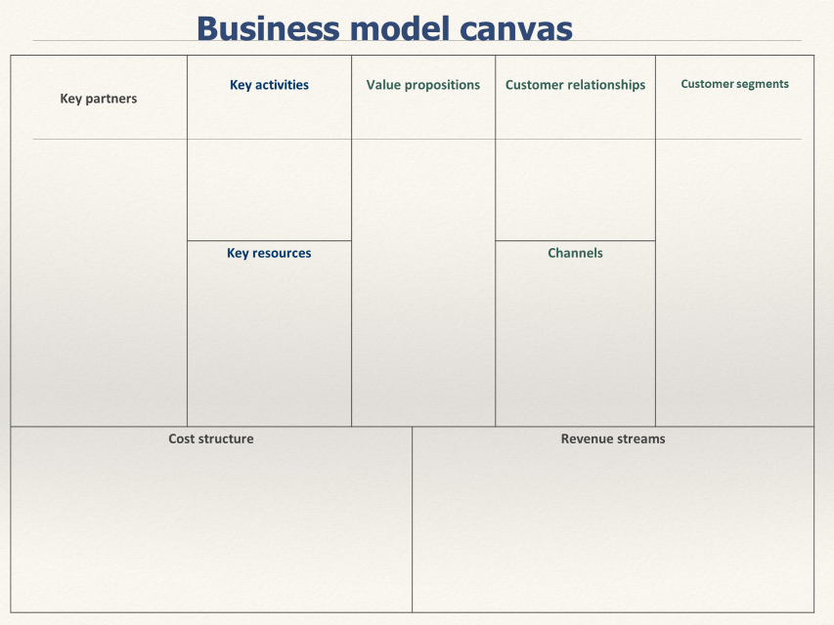
Useful advise: Making of a business model canvas – a task that could aid you in the preparation for your pitch

Slide 10

Erika Keršytė
Technology Transfer Office
Knowledge and Technology Transfer Centre
Vilnius Gediminas Technical University - VILNIUS TECH
Saulėtekio al. 11, SRC 806 kab., LT10223, Vilnius
Email: erika.kersyte@vilniustech.lt
Interoffice no. 9540; mob. +370 6142477

